Slide 1
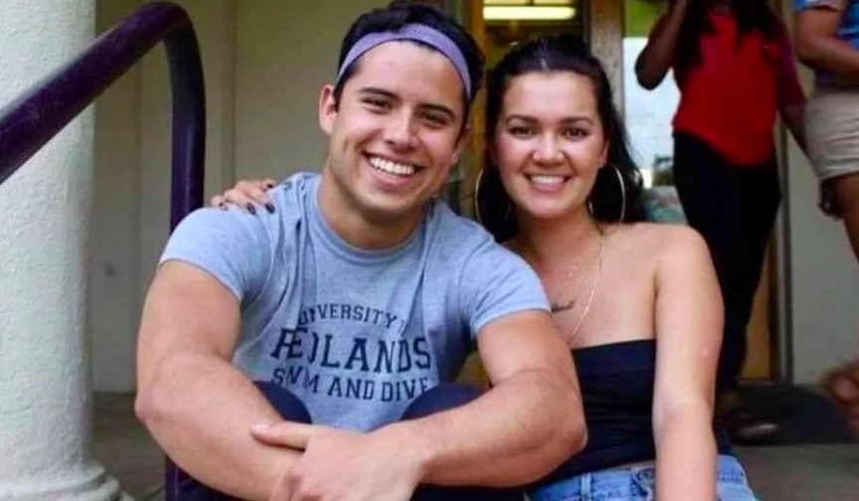
Person 3
Demographics
Name: Frank
Age: 25
Location: New York, NY
Job: Bank employee
Salary: $48,000-$60,000/year
Family: Lives with his girlfriend and a dog
Profile
As a fresh graduate, he needs to go to the bank to work on time every day. But sometimes because of work, it is necessary to exchange to a bank in another place. Her girlfriend is studying at NYU. He and his girlfriend live in a rented house in New York. They have a dog together.
Interests
· fitness
· travel and hiking
· Playing video games
Frustration
· Because of work reasons, sometimes it is necessary to move, so as to be close to the place of work, but he feels that cleaning is too much trouble when moving.· When cleaning the garden, the tools are too heavy for her to clean
Goals
· Need cleaning service after they move
· Clean the newly rented apartment

